Slide 1
Java
Production Deploy to Google Cloud

Slide 2

Google Cloud
Create account (cloud.google.com)
Create new compute engine instance
Add firewall rules for http an https (while creating)

Slide 3
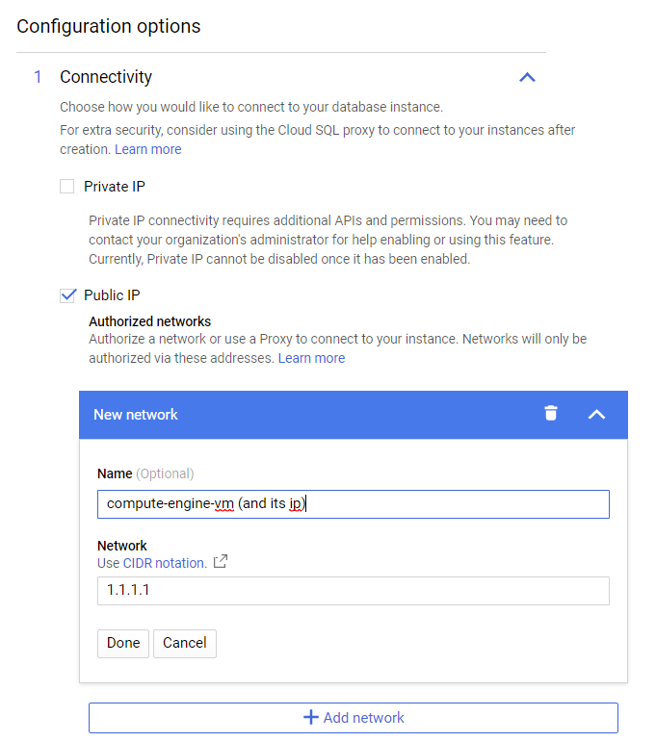

Create SQL database
Choose postgresql

Slide 4
Create SQL database

Slide 5
Prepare installation
Go to compute engine and press SSH button
In opened console give following commands
sudo apt update
sudo apt upgrade
sudo apt-get install default-jdk

Slide 6
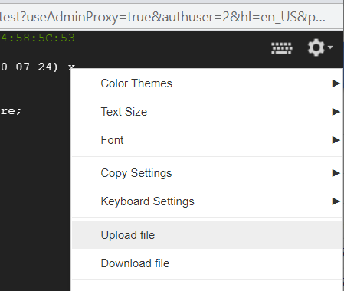
Upload .jar file

Slide 7
Add application.properties file
Insert command: vim application.properties
Press: i
Paste application.properties content:
server.port=80 spring.datasource.url=jdbc:postgresql://YOUR_SQL_IP_HERE/postgres spring.datasource.username=postgres spring.datasource.password=SQL_PASSWORD spring.datasource.driver-class-name=org.postgresql.Driver
Press: esc
Press: :wq
Press: Enter

Slide 8
Run .jar file
Run commands:
sudo chmod +x my_jar_file.jar
Test that everything works with command: sudo java –jar my_jar_file.jar
2.1) Open (in browser) http://your_vm_ip
2.2) Use ctrl+c to quit running program
3) Test that everything works with command: sudo ./my_jar_file.jar
3.1) Open (in browser) http://your_vm_ip
3.2) Use ctrl+c to quit running program

Slide 9
Make daemon process
Run commands:
sudo ln –s home/USER_NAME/JAR_NAME.jar /etc/init.d/app_name
sudo chown root:root JAR_NAME.jar
Run your service with: sudo /etc/init.d/app_name start
Stop your service with: sudo /etc/init.d/app_name stop
If you want to check logs run command: tail –f /var/log/app_name.log
To quit viewing logs press ctrl +c

Slide 10
Install apache
Change application.properties:
server.port=8080
Run commands:
sudo /etc/init.d/my_app stop
sudo apt-get install apache2
sudo a2enmod proxy
sudo a2enmod headers
sudo a2enmod ssl
sudo a2enmod proxy_http
sudo systemctl restart apache2
Make sure that your vm public ip responds

